Slide 1
Unit 1: Linear Data Structures
Linked List

Slide 2
Linked List
A linked list is a sequence of items, which are connected together via links.
Linked list is the second most-used data structure after array.
Important terms-
Node- Individual element in the linked list
Data − Each node of a linked list can store an element called a Data.
Next − A link or pointer to the next link called Next.
Head − A Linked List contains the- link to the first node called Head.
Basic Operations:-
Create
Insert Node
Delete Node
Display elements in the list/ Traverse the list

Slide 3
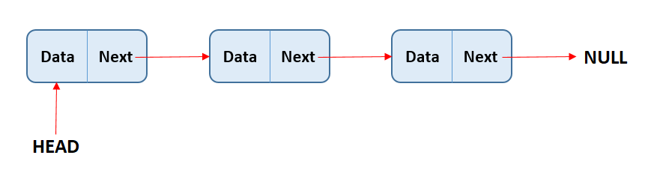
Linked List

Slide 4
Types
Singly Linear Linked List
Singly Circular Linked List
Doubly Linear Linked List
Doubly Circular Linked list

Slide 5
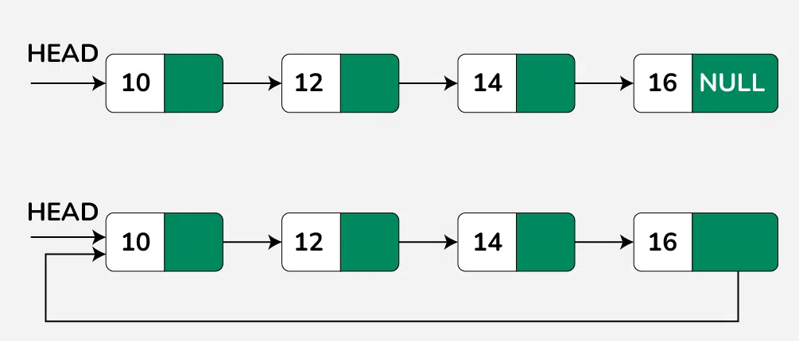
Singly Linear and Singly Circular Linked List

Slide 6
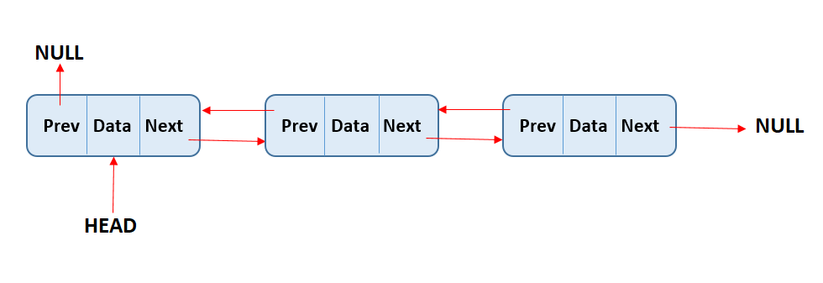
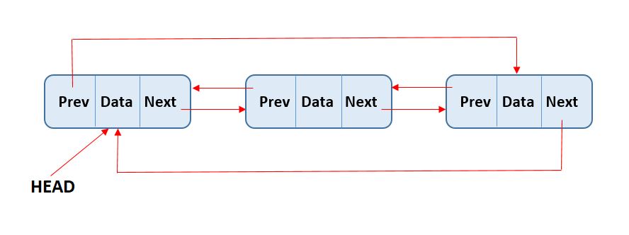
Doubly Linear and Doubly Circular Linked List

Slide 7
Basic Operations on Linked List
Traversal: To traverse all the nodes one after another.
Insertion: To add a node at the given position.
Deletion: To delete a node.
Searching: To search an element(s) by value.
Updating: To update a node.
Sorting: To arrange nodes in a linked list in a specific order.
Merging: To merge two linked lists into one.

